Slide 1
Advanced Techniques with Large Language Models Lecture 1
Northeastern University
College of Engineering
Multidisciplinary Graduate Engineering Department
INFO 6105 – Fall 2024
Instructor: Abdolreza Mosaddegh

Slide 2
Topics covered in this course
Fundamental Concepts of AI
Introduction to Deep Neural Network
Attention Mechanism
Transformer Architecture
Fundamental Concepts of LLM
Fine-tuning of LLMs
Applications of LLMs
Reasoning in LLMs
Knowledge Management in LLMs
Prompting Techniques
Security, Bias and Alignment issues in LLMs

Slide 3
Course Overview
Course Title: Advanced Techniques with Large Language Models
Course Number: INFO 7374
Term and Year: Fall 2024
Credit Hour: 4
Course Format: On-Ground
Instructor: Abdolreza Mosaddegh
Email : a.mosaddegh@northeastern.edu
TA: Shubham Krishnakumar Nair
TA Email: nair.shu@northeastern.edu
Assignments and Resources: Canvas

Slide 4
Grading
Assignments: 45%
Midterm Exam: 15%
Final Exam: 20%
Final Project: 20%
Lecture: +5% Additional

Slide 5
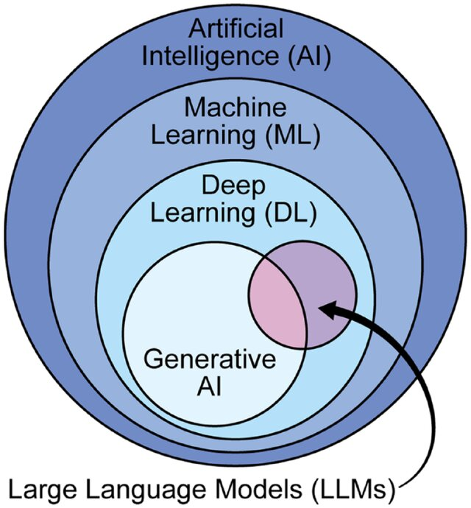
Artificial Intelligence: a field of computer science enables machine to imitate human intelligence
Machine Learning: Field of study that gives computers the ability to learn without being explicitly programmed
Generative AI: a broad term that can be used for any AI system whose primary function is to generate content.
Large language model (LLM): Deep Learning models trained on huge amounts of data making them capable of processing natural language and other types of content to perform a wide range of tasks.
Notes:
AI does not always imply a learning-based system
e.g., Rule based system

Slide 6
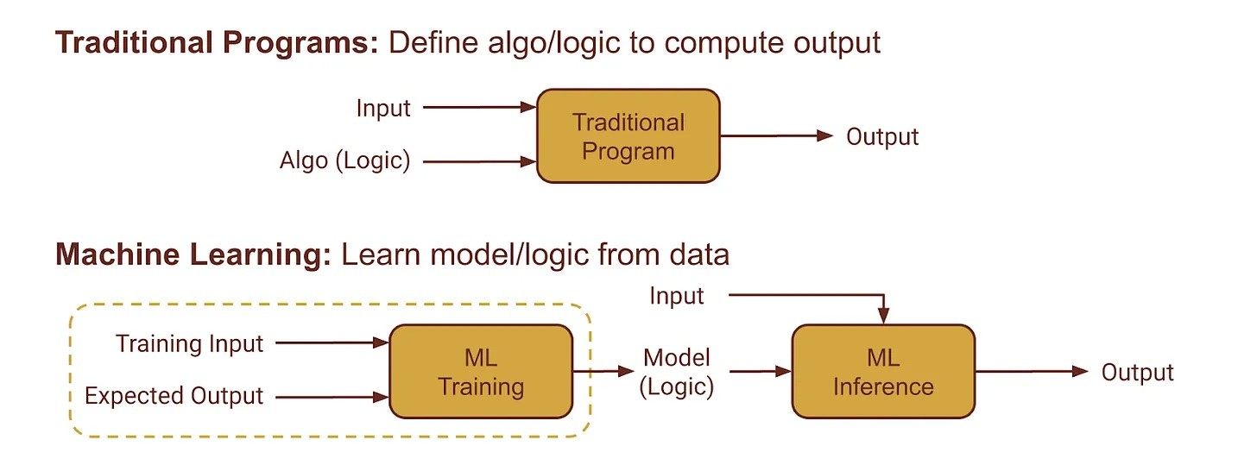
Learning vs Programing
Programming: Explicit instructions for the computer to follow.
Learning: Models can learn from data.

Slide 7
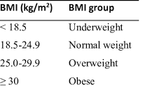
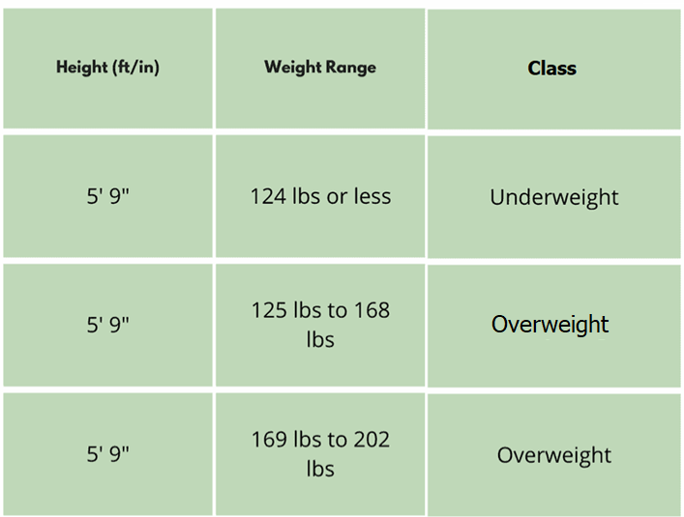
Learning vs Programming - Example
Grouping patients based on BMI
Programming:
If (Height / Weight) < 18.5 then Underweight
If (Height / Weight) >= 18.5 then Normal
…
Machine Learning:
Group patients based on similarity with Height and Weight in data records
Features
Labels

Slide 8
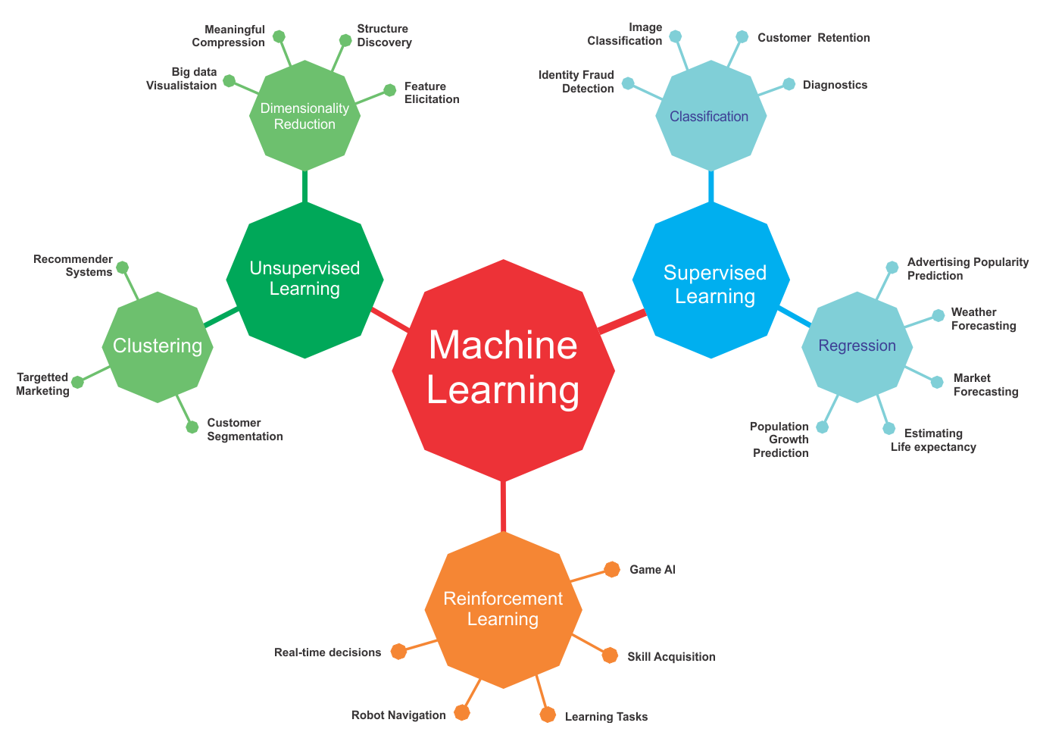
Semi-Supervised
Learning using unlabeled data
Self-Supervised
Learning using labeled data
packt
Learning through Interactions with an environment

Slide 9

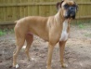
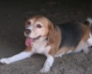




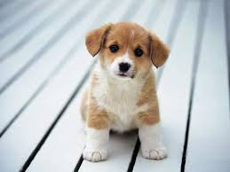
A Typical Supervised Learning
Labeled Training Data
“dog”
“dog”
“dog”
“dog”
“dog”
“cat”
“Features”
“dog”
“cat”
“cat”
“cat”
“cat”
The feature extraction phase may be part of the machine learning algorithm itself
“cat”
Training
Cat=0
Unknown Data /
Test Data
Classification Model
Predicted Label
Dog=1
“Features”
Production /
Testing

Slide 10
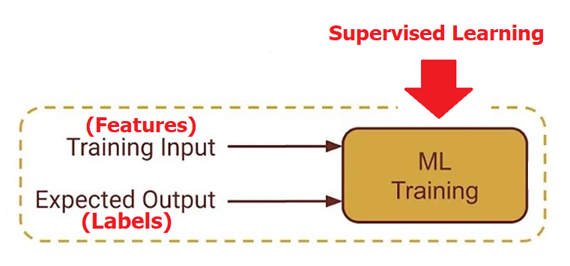
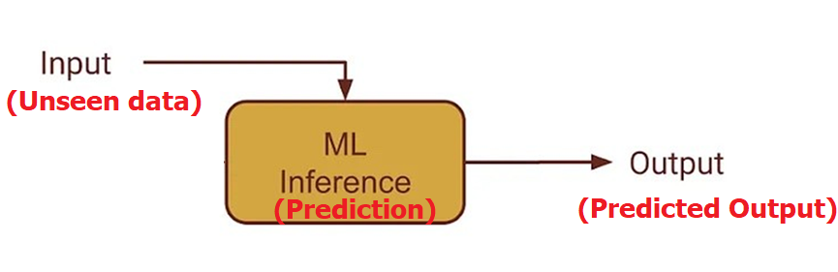
Supervised Learning
Predicting a class/value for new data based on data in training set
Training data includes both inputs (features) and desired outputs (Labels).
Goal : Predict new (unseen) data with the least error.

Slide 11
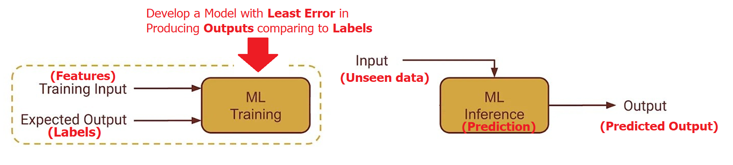
Problem Statement
Develop a model classify predict new data with the least error
To quantify the error, we need to define a measure (Loss Function)
A loss function compares the label against the output that our model currently predicts

Slide 12
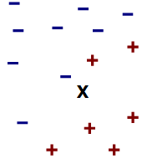
K Nearest Neighbor (KNN)
KNN is a supervised learning technique (Classifier).
Classify a new data point like similar existing training example(s).
Similar means similar feature values (nearest feature values)
Height
← Normal(-) or Overweight(+) Class?
Weight
Idea: Similar features indicates similar class
12

Slide 13
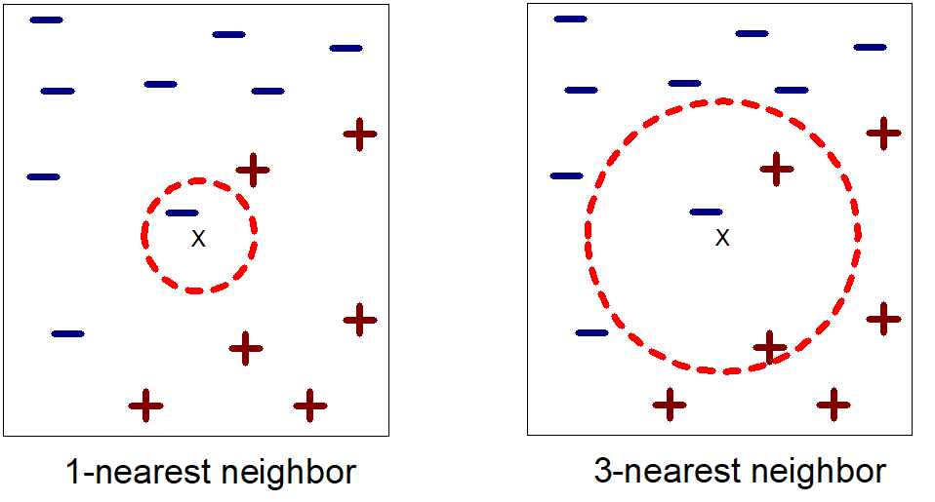
Example of Nearest Neighbors
K-nearest neighbors of a record x are data points that have the k smallest distance to x
Class of x is assigned based on majority of k K-nearest neighbors
Distance is the Loss Function in KNN
We need a measure for distance

Slide 14
Distance as Loss Function
Euclidean Distance:
Manhattan Distance:
Chebyshev Distance:
$$d(x,y)=\sqrt{(x−y)^{2}}=\sqrt{\sum_{i=1}^{d}{(x_{i}−y_{i})^{2}}}$$
$$d(x,y)=|x−y| =\sum_{i=1}^{d}{|x_{i}−y_{i}|}$$
$$d(x,y)=max_{1≤i≤d}|x_{i}−y_{i}|$$
1 2 3 4 5
Feature 2
X (1,5)
$$Euclidean=\sqrt{\sum_{i=1}^{d}{(x_{i}−y_{i})^{2}}}= ({(1−3)}^{2}+{(5−1)}^{2})^{\frac{1}{2}}=4.47$$
$$Manhattan=\sum_{i=1}^{d}{|x_{i}−y_{i}|}=|\left(1−3\right)|+|(5−1)|=6$$
$$Chebyshev=Max(\left|\left(1−3\right)\right|,|(5−1)|)=4$$
$$4$$
Y (3,1)
$$2$$
Feature 1
1 2 3 4

Slide 15
KNN Example
Features: height(cm) and weight (kg)
Labels: Normal , Underweight
Weight | Height | Class (Label)
62 | 182 | Normal
69 | 176 | Normal
56 | 174 | Underweight
58 | 169 | Normal
57 | 173 | Underweight
55 | 170 | Normal
Datapoint with Unknown Class
57 kg | 170 cm | ?

Slide 16
KNN Example – Calculate Loss
Euclidean Distance = $\sqrt{(Weight1−Weight2)^{2}+(Hight1−Hight2)^{2}}$
Weight | Height | Class | Euclidean Distance
62 | 182 | Normal | 13
69 | 176 | Normal | 13.4
56 | 174 | Underweight | 4.1
58 | 169 | Normal | 1.4
57 | 173 | Underweight | 3
55 | 170 | Normal | 2
$$\sqrt{(62−57)^{2}+(182−170)^{2}}$$
$$\sqrt{(69−57)^{2}+(176−170)^{2}}$$
$$…$$
57 kg | 170 cm | ?
Unknown data point

Slide 17
3-NN Example – Least Distance (Loss)
Weight | Height | Class | Euclidean Distance
62 | 182 | Normal | 13
69 | 176 | Normal | 13.4
56 | 174 | Underweight | 4.1
58 | 169 | Normal | 1.4
57 | 173 | Underweight | 3
55 | 170 | Normal | 2
K=3
Normal
57 kg | 170 cm

Slide 18
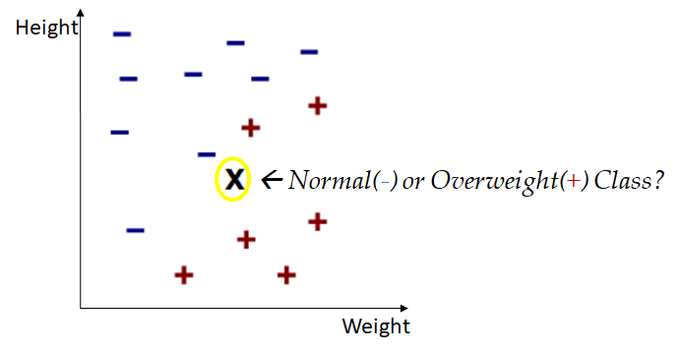
3-NN Example - Accuracy
Height | Weight | Predicted Class | Real Class
57 kg | 170 cm | Normal | Normal
62 kg | 185 cm | Underweight | Underweight
61 kg | 168 cm | Underweight | Normal
65 kg | 170 cm | Normal | Normal
Accuracy = Number of Correct Prediction / Total Predictions
= 3 /4 = 0.75
What is the ideal Accuracy ?

Slide 19
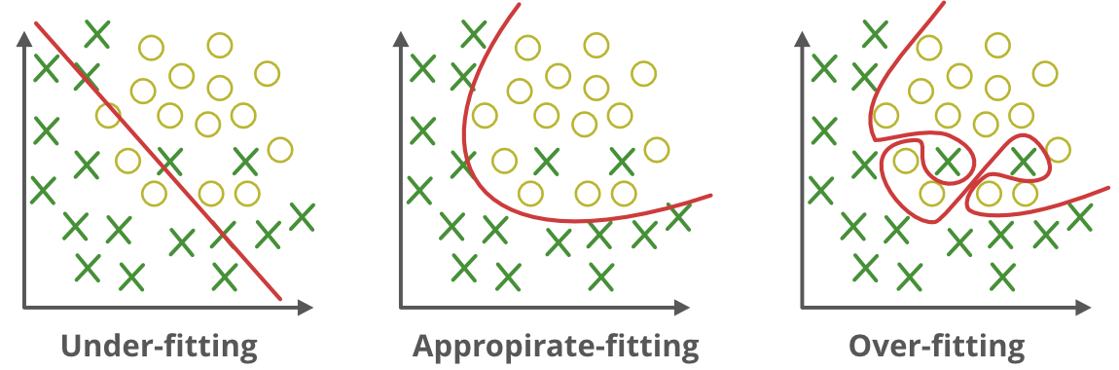
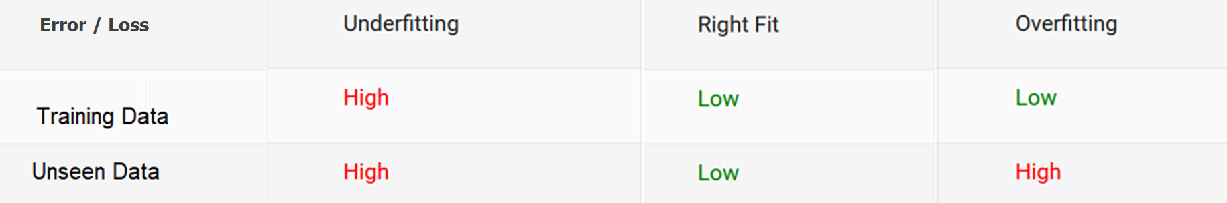
Under-fitting vs Over-fitting
Our goal is not just to create a model that perform well on data used for training the model but also perform well for unseen data

Slide 20
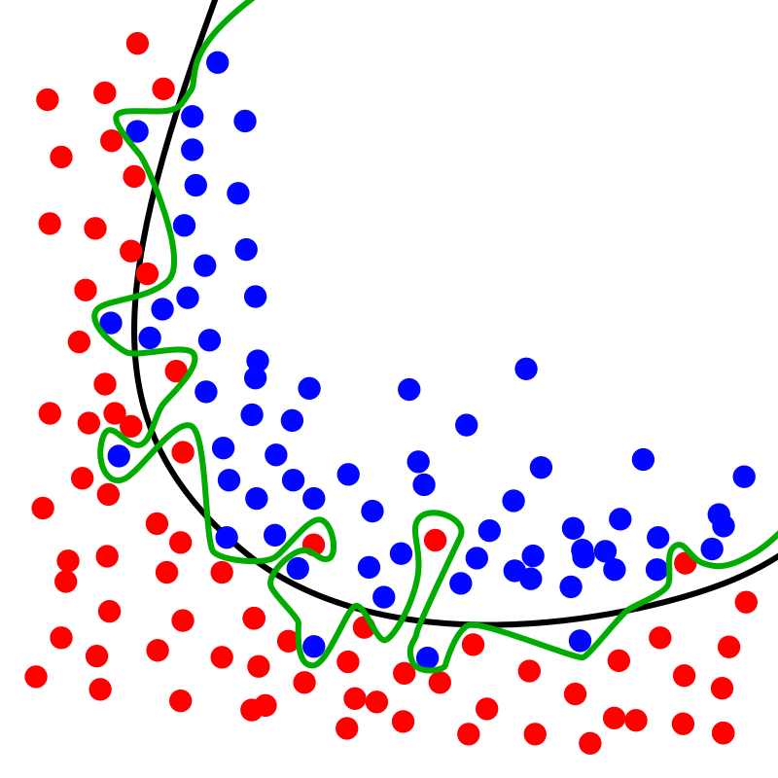
Avoid Overfitting
Using algorithms which are more robust against overfitting
Reducing complexity of model
Train with more data
Using validation data
...

Slide 21
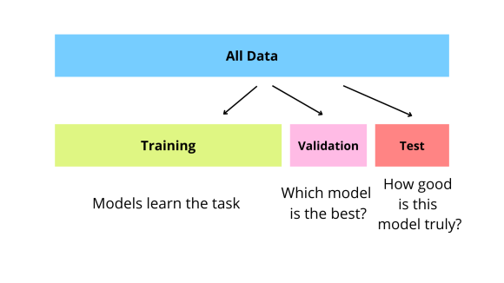
Train / Test/ Validation
To resolve the overfitting issue, we usually split into three subsets:
Train
Test
Validation
Best practice:
Train : 70%-80%
Validation : 5%-10%
Test: 10%-25%

Slide 22
Splitting Train and Test data
Train and test data should be separate completely
We should not touch test set during training
Before training/learning, randomly split train and test data
The test set must simulate a real-world scenario using unseen data
Avoid over-sampling , under-sampling, etc. on test data

Slide 23
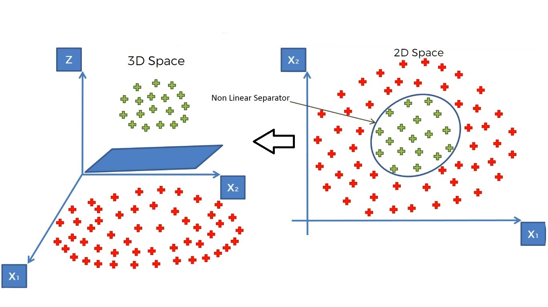
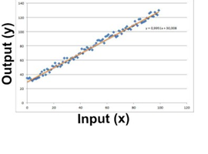
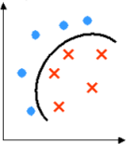
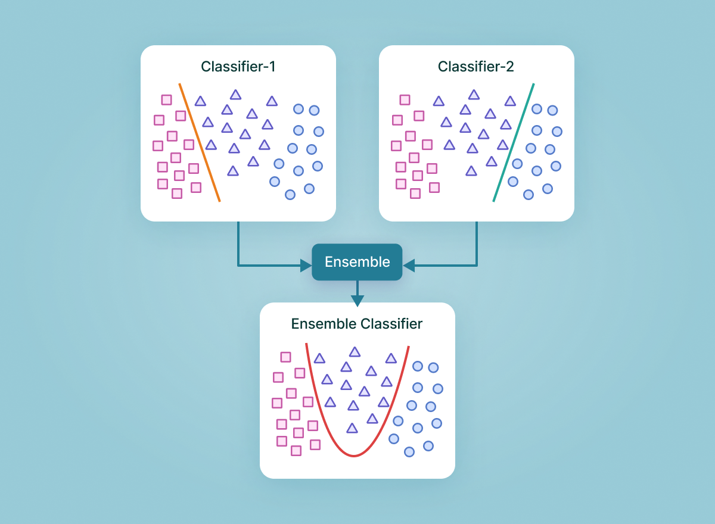
Some Supervised Approaches
Regression
Learn a line/curve (the model) using training data consisting of
Input-output pairs.
Use it to predict the outputs for new inputs
Linear Regression
Logistic Regression,
Support Vector Machines
SVM
Support Vector Machine (SVM) models have the ability to perform a non-linear regression / classification by mapping their inputs into high-dimensional feature spaces
Classification
Learn to separate different classes (the model) using training data consisting of input-output pairs
Use it to identify the labels for new inputs
Ensembles
Ensemble methods are machine learning techniques that combines several models in order to produce optimal models
Two-Class Nonlinear Classification
Support Vector Machines, Decision Trees,
Neural Networks

Slide 24
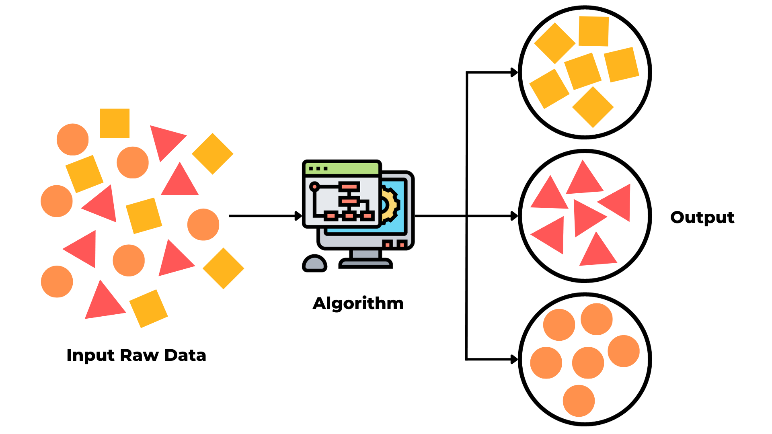
Unsupervised Learning
Learning about relations in data
Most available data is unlabeled
Labeled data can be expensive and time-consuming to obtain
Goal:
Reveal structure of data
Detect similarities / distances
Detect anomalies
Extracting patterns
Summarizing data
Discovering associations.

Slide 25
A Typical Unsupervised Learning
Unlabeled Data
“Features”
Clustering
Model
Cluster 1
Cluster 2

Slide 26
Loss Function in Supervised vs Unsupervised
Supervised learning
A loss function is used to choose a particular model with the lowest loss value
After training and testing the model, we don’t care about the loss function
Unsupervised learning
A loss function characterizes what the data looks like
The loss function is our data model, and is itself our primary goal

Slide 27
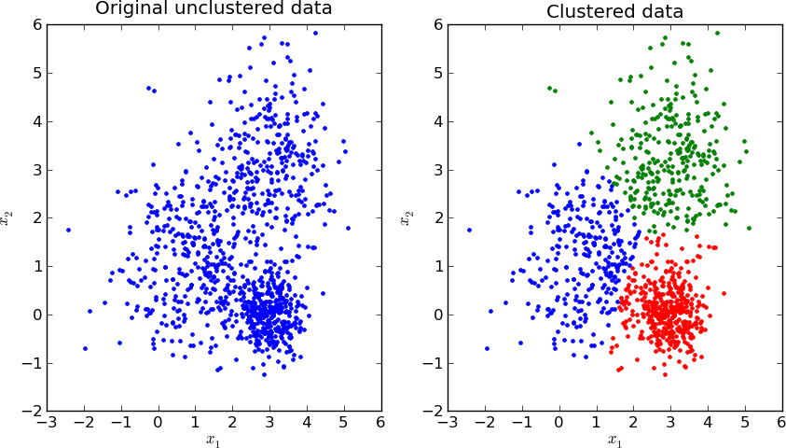
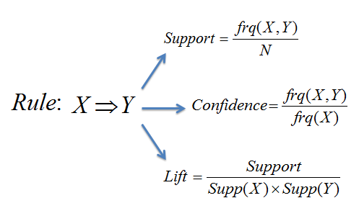
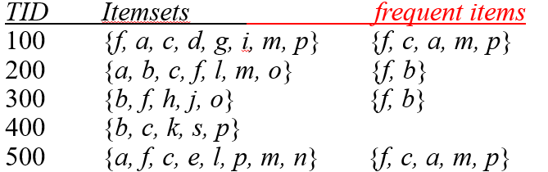
Some Unsupervised Approaches
Clustering
Learn the grouping structure for a given set of unlabeled inputs
k-Means, Hierarchical Clustering, ...
Association Rules
Association rule mining is a rule-based machine learning method for discovering interesting relations between variables in transactional databases.
Apriori, FP-growth, …

Slide 28
Clustering
Clustering is often an unsupervised learning task as no class values (labels) indicate group of the data instances.
Clustering is a technique for finding similar groups in data, called clusters
Clustering groups data instances that are similar to (near) each other in one cluster and data instances that are not similar (far away) to each other into different clusters.
Features used to recognize similarity of clusters
Clustering Type

Slide 29
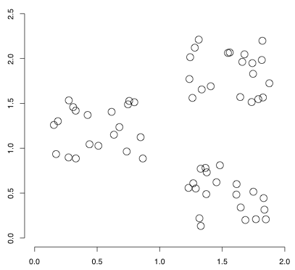
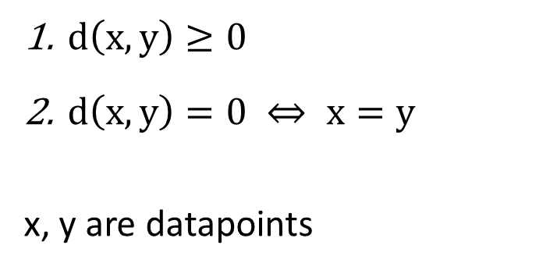
Similarity vs. Distance
Similarity indicates less distance between attributes (features) of two data points
A distance measure (metric) is a function that satisfies:
Distance is the Loss Function in clustering
$d\left(x,y\right)≥0$
$d\left(x,y\right)=0 ⇔ x=y$
x, y are datapoints

Slide 30
K-Means Clustering Algorithm
Given k as number of clusters (Hyper-parameter):
Select k random data points as initial centroid (cluster representative)
Repeat
Assign each data point to the nearest centroid
Recompute centroid of each cluster using mean values of attributes
Until convergence criteria is met

Slide 31
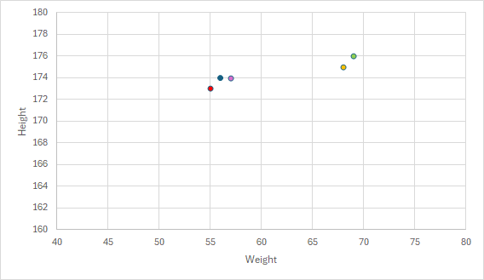
Sample of K-means with two cluster
Features: height(cm) and weight (kg)
No Labels
Weight | Height
68 | 175
69 | 176
57 | 174
55 | 173
56 | 174

Slide 32
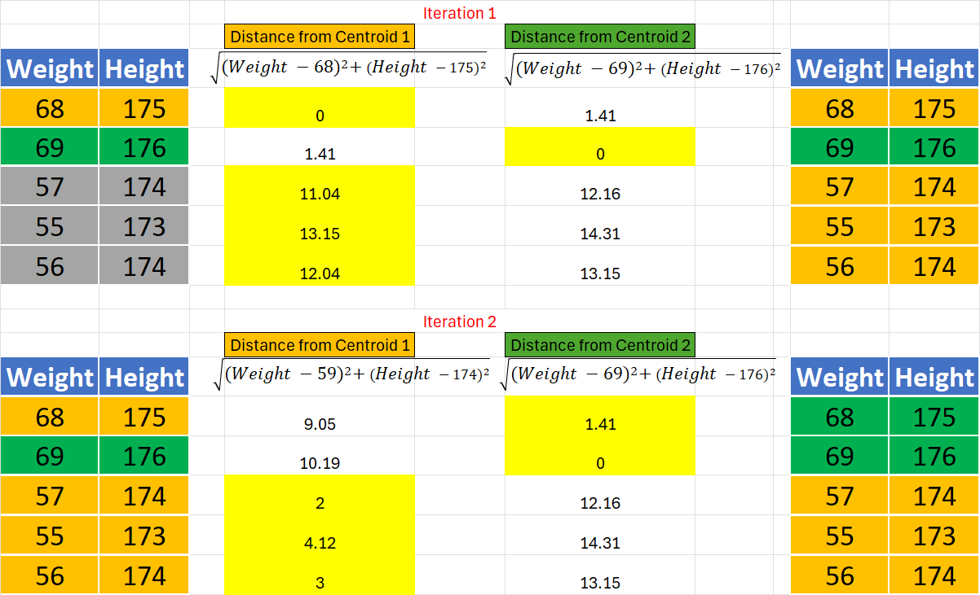
Sample of K-means with two cluster
Choose two random data points as Centroids of Cluster Orange (Cluster 1) and Cluster Green (Cluster 2)
Centroid 1 =
( (68+57+55+56) /4 , (175+174+173+174) /4 ) = (59,174)
Centroid 2 = (69,176)
Repeat Calculation
With Centroids C1, C2
Unless the change in Centroid is less than 1%
Centroid 1 =
((57+55+56) /3 , (174+173+174) /3 ) = (56,173.6)
Centroid 2 =
((68+69) /2 , (175+176) /2 ) = (68.5,175.5)

Slide 33
Local Optimal Problem
Greedy Algorithm makes locally optimal choices at each step, Not globally optimum necessarily

Slide 34
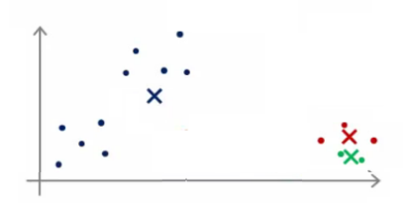
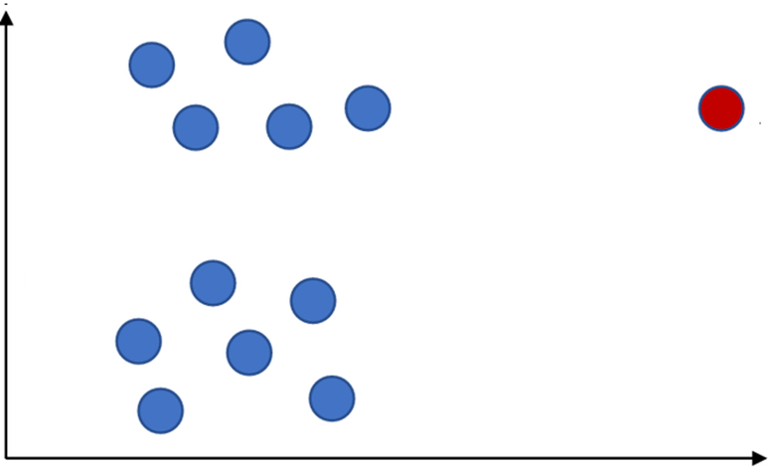
K-means Characteristics
Sensitive to initial points.
Sensitive to noisy data and outliers

Slide 35
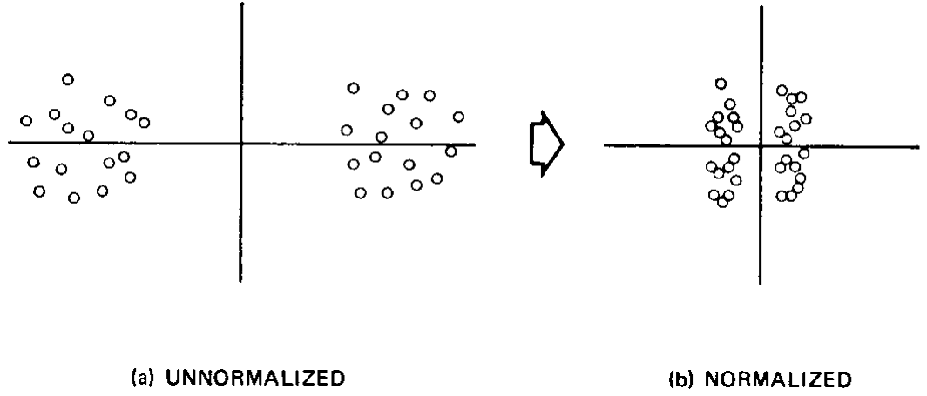
Data Pre-processing for Clustering
Missing Values are required to be imputed before clustering since distance metrics are employed.
Categorical variables need to be recoded into a series of variables which can then be used in calculation of distance.
Normalizing data is recommended since attributes with larger range of values can bias some distance measures.
Filter out outliers is recommended for many clustering algorithm such as K-means which are prone to outliers

Slide 36
Impute Missing Data
Ignore the tuple: not effective when many records have missing values or dataset is small
Fill in the missing value manually: not feasible when there are many missing values
Fill in it automatically with
a global constant value: e.g., 0, “unknown”, a new class
last reported value in historical data: assumes no change, which is usually wrong
value of a record with similar other attributes (Hot Deck Imputation)
the attribute mean
the attribute mean for all samples belonging to the same class / group
Imputation using prediction models: predict value of missing data using values of other attributes by a prediction model (e.g., regression)
Multiple Imputations (e.g., MICE)

Slide 37
Types of Missing Data
Missing completely at random (MCAR): the missing data is independent of the observed and unobserved data (no systematic differences exist between participants with missing data and those with complete data) → imputable
e.g., some data items are missed due to hardware failure
Missing at random (MAR): the missing data is systematically related to the observed but not the unobserved data → imputable
e.g., male participants are less likely to answer a question on having depression
Missing not at random (MNAR): the missing data is systematically related to the unobserved data, that is, the missingness is related to events or factors which are not measured by the researcher → analysis is likely biased without these values
e.g., answers of criminals to the number of crimes they committed

Slide 38
Multiple Imputation with Chained Equations
MICE is a technique used to impute (fill in) multiple variables by modeling each variable with missing values as a function of the other variables in the dataset using a supervised algorithm (e.g., regression).
cran.r-project

Slide 39
Outliers
Outliers are data points that deviate significantly from the rest of the data
Outliers can influence results of analysis
r = -.426
r = -.567
Same data, changed one value from 37 to 150

Slide 40
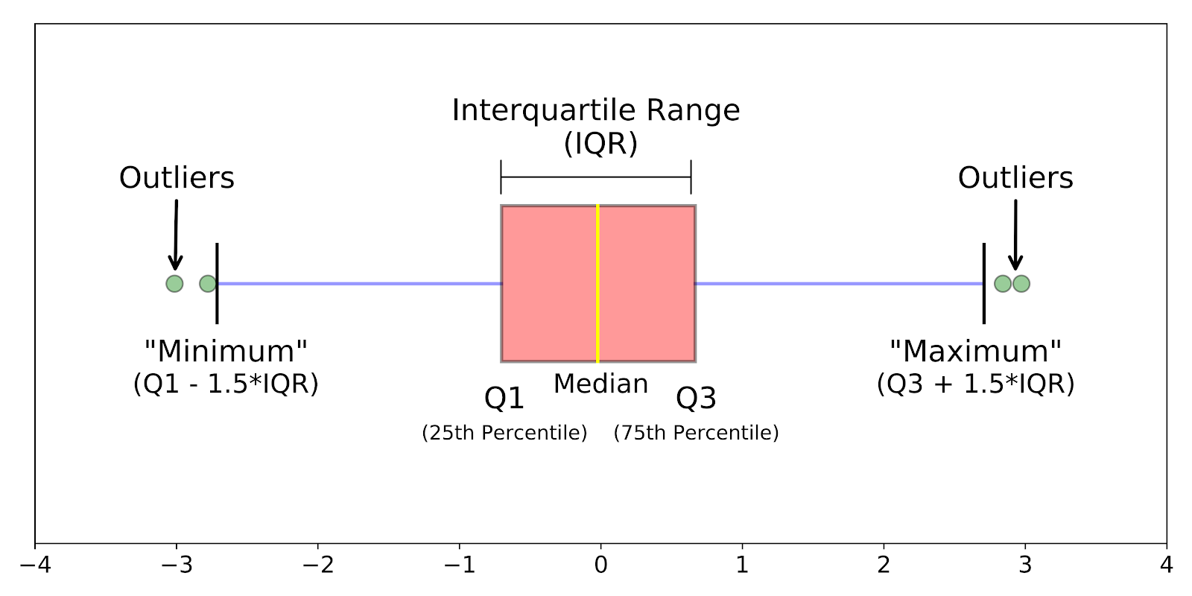
Identifying Outliers using Boxplots
IQR (interquartile ) method
set up a “fence” outside of Q1 and Q3. Any values that fall outside of this fence are considered outliers.
To build this fence take 1.5 times the IQR and then subtract this value from Q1 and add this value to Q3
neptune
In Python : q3, q1 = numpy.percentile(data, [75 ,25])

Slide 42
Addressing Outliers
Outlier as a noncompliance (Invalid)
E.g., age of 200 --> Delete the outlier
--> Replace the outlier with a value
Outlier as a real extreme value
E.g., Bill Gates salary --> Deleting valid cases biases your sample
Outlier as output
E.g., detecting fraud --> Outliers are outputs of process

Slide 43
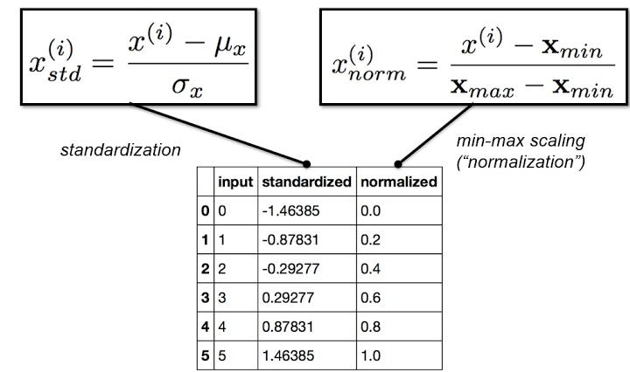
Normalizing Data
Data normalization is a technique to transform the values of a dataset into a uniform scale (e.g., 0-1).
Some machine learning algorithms and loss functions are sensitive to the scale of the features.
min-max normalization: preserve scale but does not handle outliers well. A value between 0 and 1
New value = (Original value - Min) / (Max - Min)
z-score normalization: better handling of outliers but not exact same scale
New value = (Original value - Mean) / Standard deviation
Normalizing can make the outliers less influential.
Normalization can result in a loss of information in some datasets

Slide 44
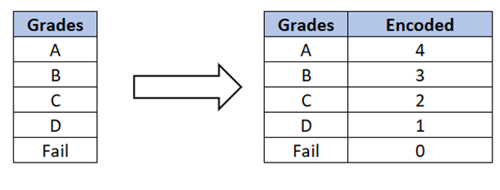
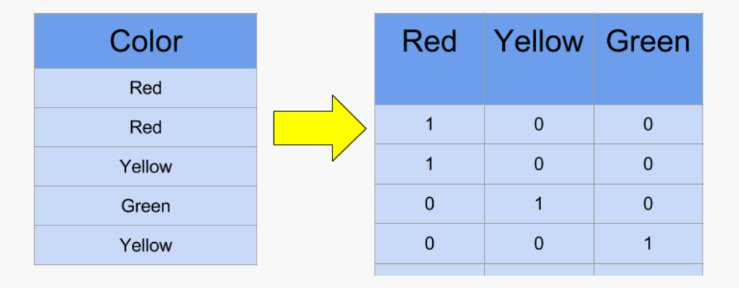
Processing of Categorical Data
In some statistical and machine learning models the inputs should be numeric values
Nominal categorical variables are labels that take only a finite number of values without orders (e.g., colors)
It is incorrect to replace labels with different numerical values in a statistical model
Hot-encoding (dummy variable encoding) can be used for converting labels to numerical values
Ordinal categorical variables are labels that take only a finite number of values with orders (e.g., grades)
Sometimes labels can be replaced with different numerical values in a statistical model
Hot-encoding usually can be used for converting categories to numerical values

Slide 45
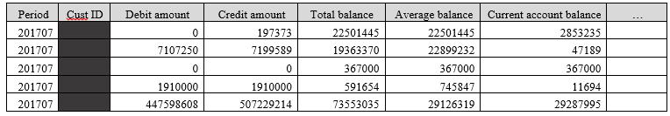
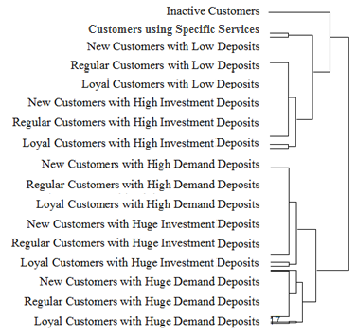
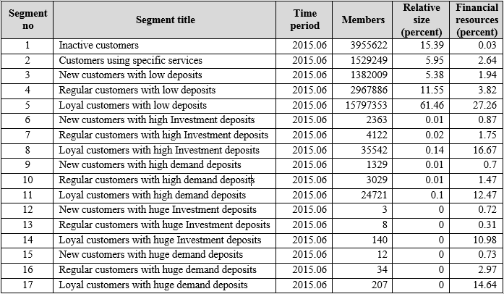
Semi Supervised
Labeled data is limited
Finding representations for supervised or other unsupervised models
Unlabeled data
Hierarchical Clustering
Using labeled data in other ML models

Slide 46
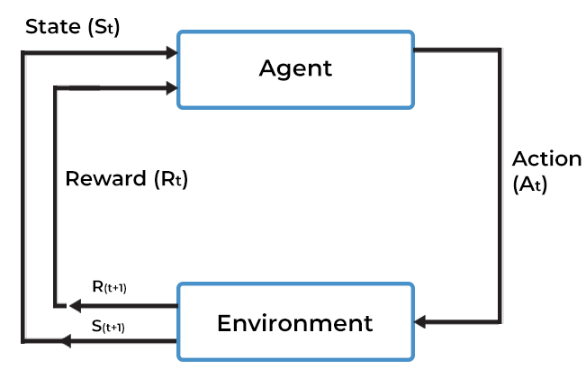
Reinforcement Learning
Learning optimal behaviors in an environment
In reinforcement learning, there is no answer/ label
Goal: obtain maximum rewards (and less penalties)

Slide 47
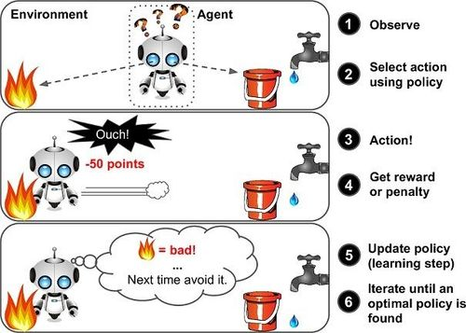
Typical Reinforcement Learning
marutitech

Slide 48
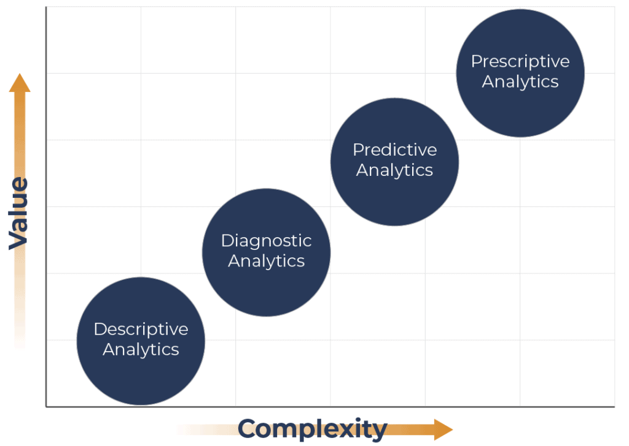
Types of Analytics
What should be done?
What is likely to happen?
Descriptive
Decision support systems, Autonomous Systems
Why did it happen?
Regression, Classification
What happened?
Correlations, Cluster Analysis, …
Gartner
Visualizations, Reports, …
Hindsight
Insight
Foresight

Slide 49
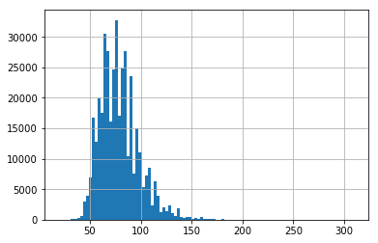
Visualization- Distribution
Histogram allows the inspection of the data for its underlying distribution

Slide 50
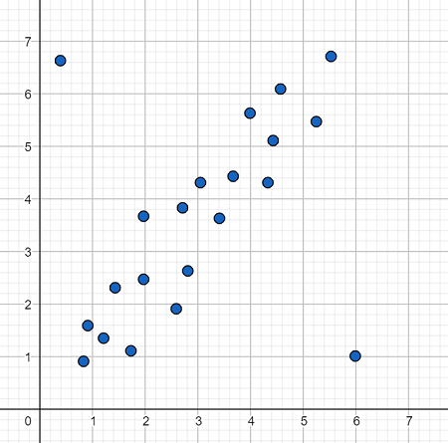
Visualization- Noises and Outliers
Scatter plot showing noises and outliers

Slide 51
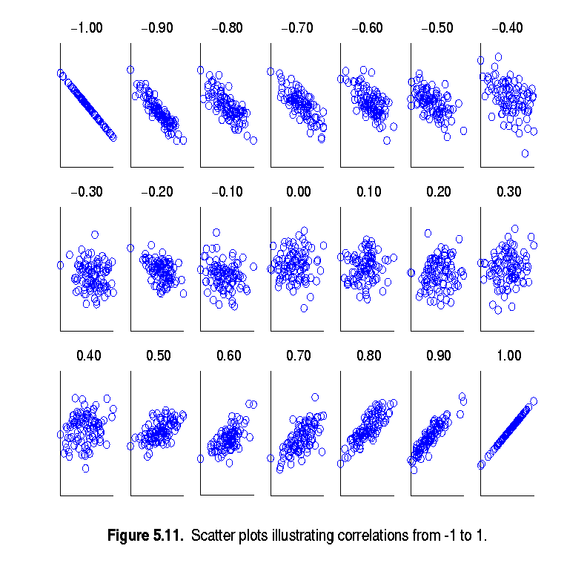
Visualization - Correlations
Scatter plots showing the correlations between two features
(from –1 to 1)

Slide 52
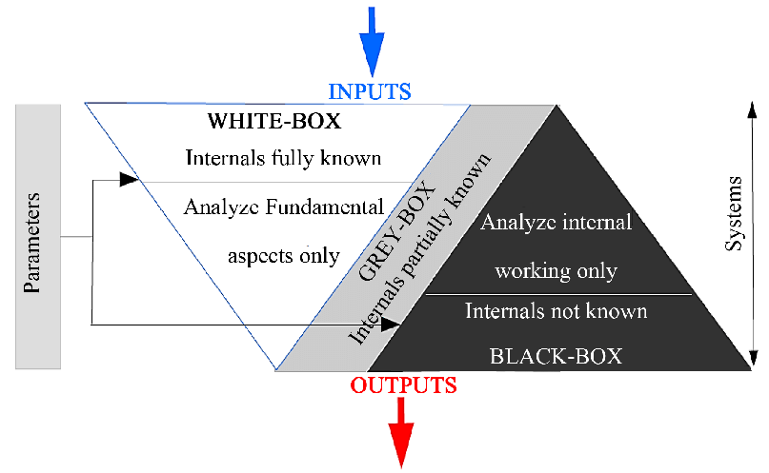
Predictive Analytics - White-box vs. Black-box ML
Interpretable results for developing data-driven theories
Transparency makes more reliable results than opaque models
High predictive accuracy
Highly complex models

Slide 53
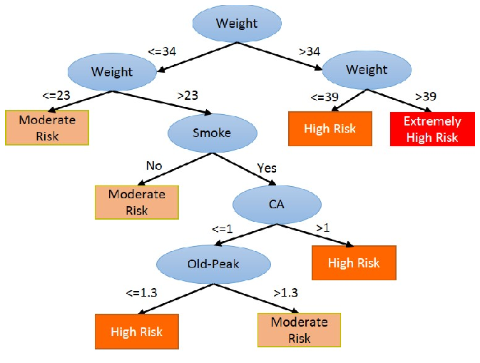
Predictive Analytics - White-box Models
Decision Trees

Slide 54
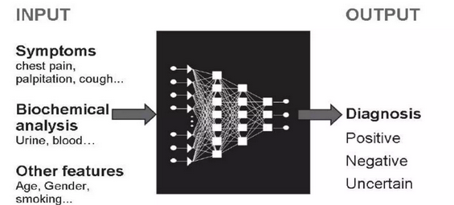
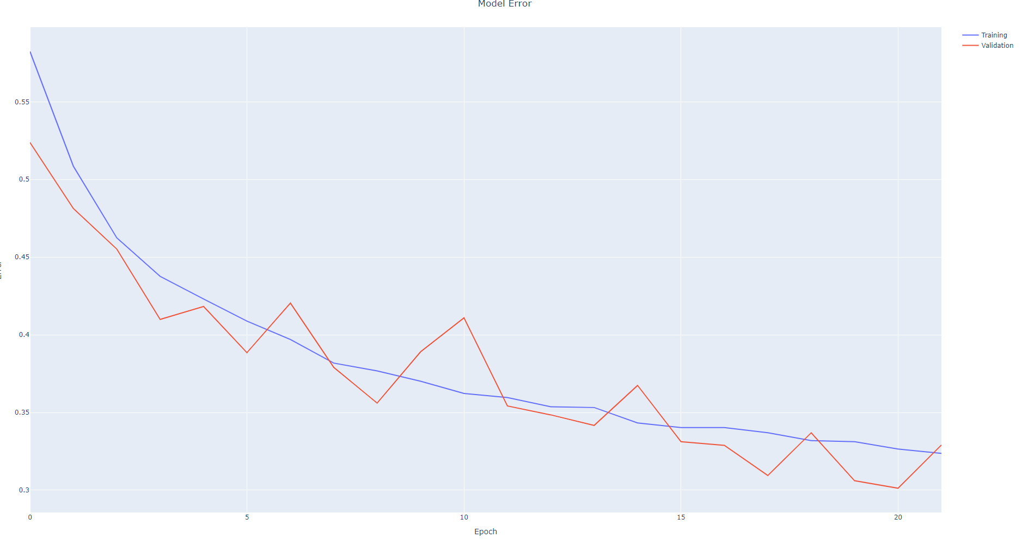

Predictive Analytics - Black-box Model
Interpretation of such results is not straight forward
Less reliable since the mechanism of making outputs in not easily interpretable
ECG Classification
Neural Network

Slide 55

Explainability
Some application needs more interpretability
More impactful decisions, needs more explainability
Explainable AI tries to address this issue
1
Impact
0
0
Explainability
1

Slide 56


Explainability – Health Data

Slide 57

Assignment 1
The dataset contains information of patients and heart-attack column (label) which indicates that a patient is predicted heart-attack (1) or not (0)
Develop a code using a common programing language (Python, R, Java, C#, C++, etc.) over the dataset to:
-split data into training and test (25% test data)
-classify training data with KNN-3 and KNN-5
-Calculate the accuracy of both models
Submit the code and the results in Canvas as follows:
File name of Code : HW1_Code.[file type] (e.g., HW1_Code.py )
File name of Result : HW1_Result.docx

